Slide 1
Project Task 2: Executive Summary Data Presentation and Visualization
Alberto Luma

Slide 2
Project analysis slide 2
Project Analysis
Executive Summary
Available Seats per week by Airlines
PROJECT
OVERVIEW
US Data Analysis
Data Comparison Worldwide
Conclusion
250-word Summarized Paper

Slide 3
Executive Summary
The number of passengers killed in plane crashes increased sharply in 2018, according to new analysis. according to Dutch aviation consulting firm To70 and the Aviation Safety Network, it is recorded that there were more than 500 deaths reducing from passenger airline crashes in 2018, but both groups emphasized that fatal crashes remain rare.
Over the last two decades, aviation deaths around the world have been falling. As recently as 2005, there were 1,015 deaths aboard commercial passenger flights worldwide, the Aviation Safety Network said. Despite the increase, 2018 was still the third safest year ever in terms of the number of fatal accidents and the ninth safest measured by deaths, the Aviation Safety Network said.
The goal of this presentation is to show the enormous progress in terms of safety in the past two decades.

Slide 4
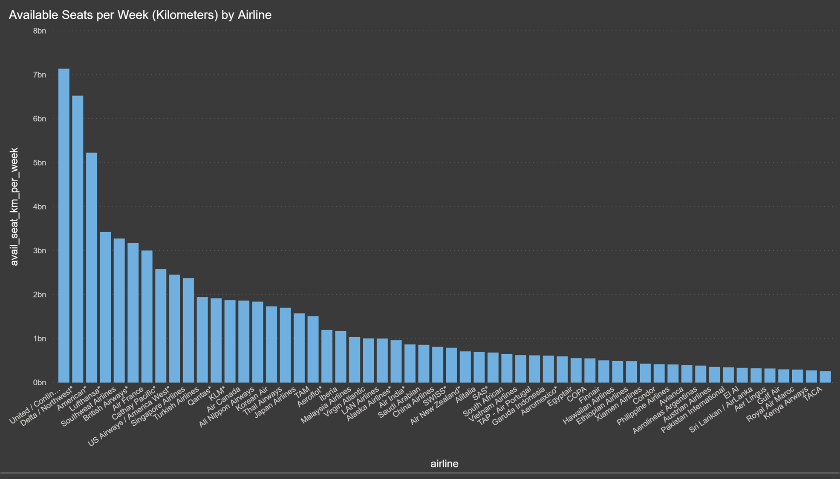
Project analysis slide 5
Available Seats per week by Airlines
Creating a bar graph representing the available seats per week by airline is a great way to show that having the greatest amount of available seats does not always represent a higher risk when it comes to fatalities or serious incidents.

Slide 5
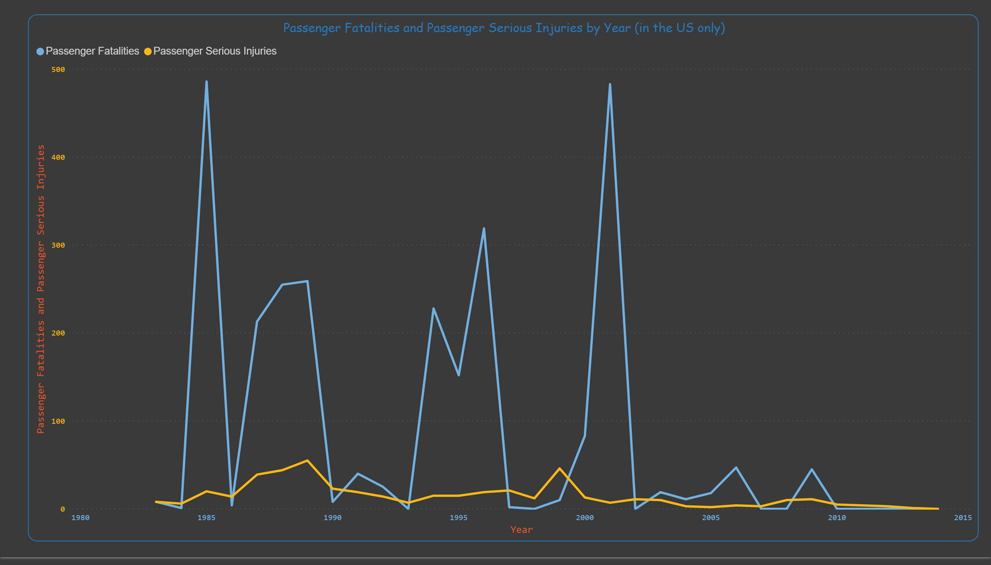
US Data Analysis
US Airline Fatalities was used to analyze passenger fatalities and passenger serious injuries for US airlines between 1983 and 2014. By using this dataset, I concluded that the biggest passenger fatalities were 486 cases in 1985, 319 in 1996, and 483 in 2001.

Slide 6
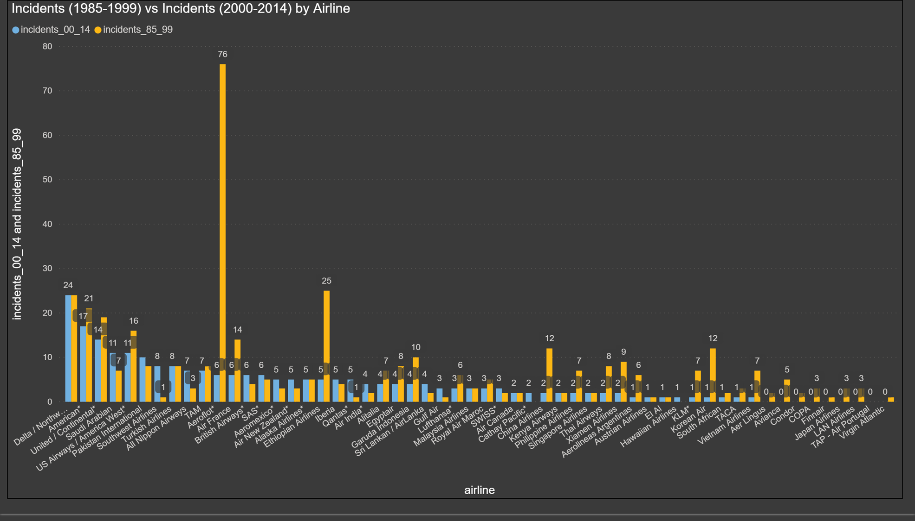
Data Comparison Worldwide

Slide 7
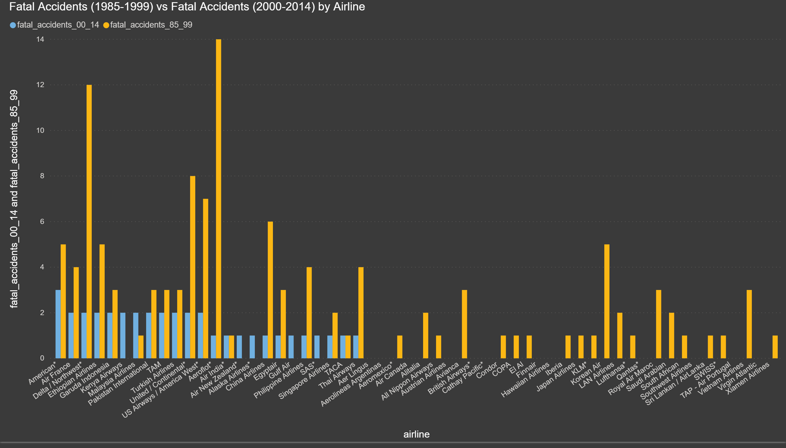
Data Comparison Worldwide

Slide 8
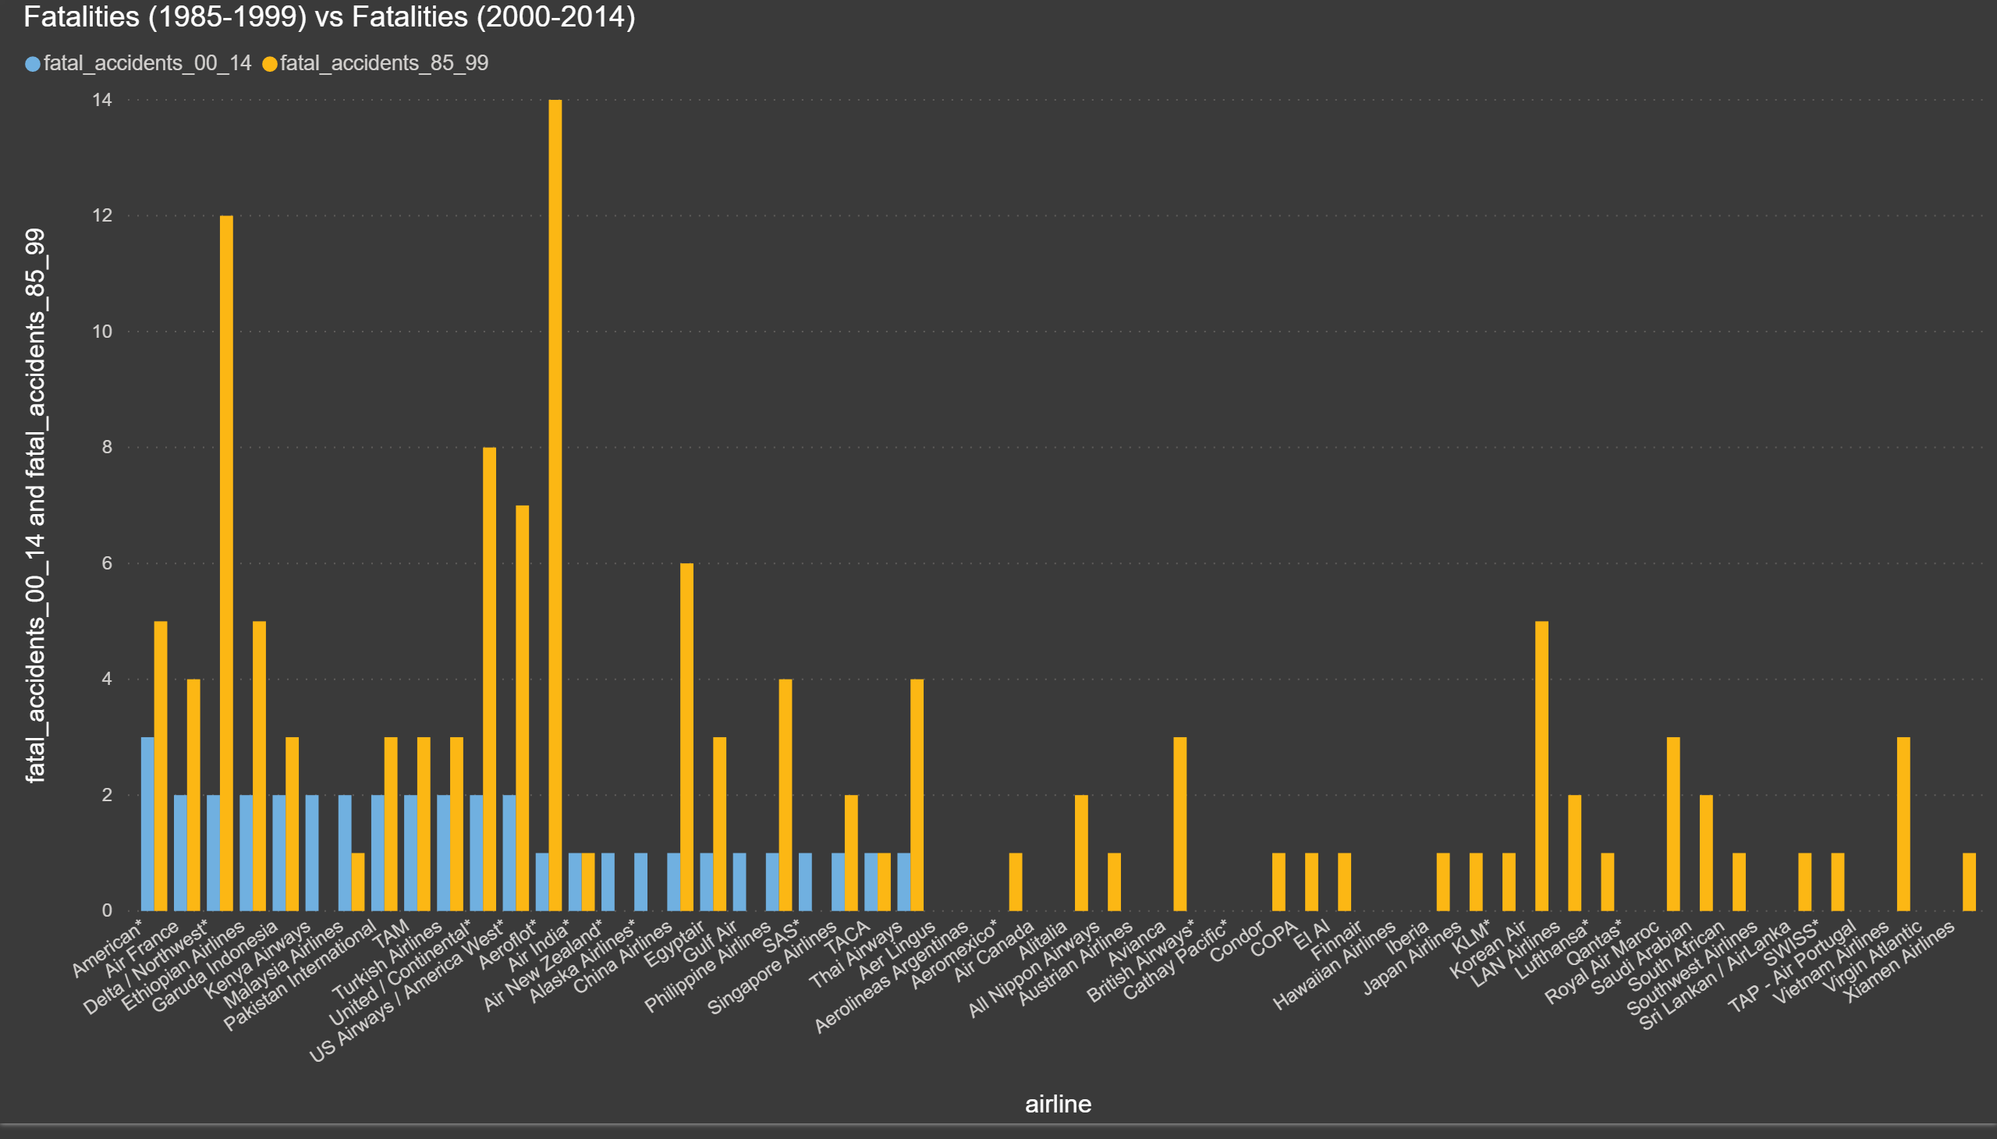
Data Comparison Worldwide

Slide 9
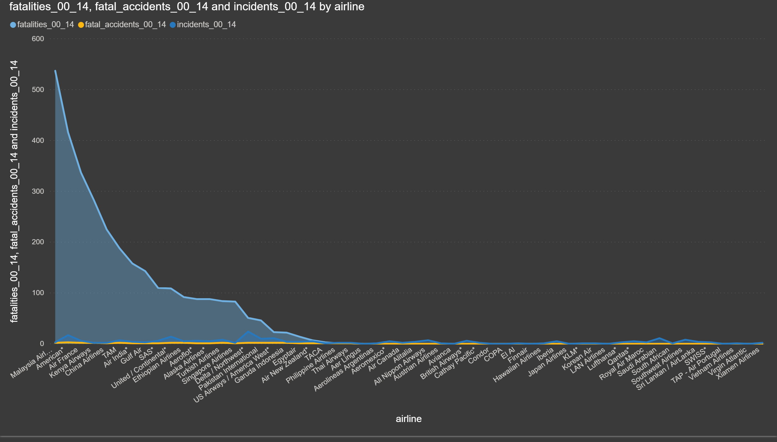
Data Comparison Worldwide

Slide 10
Project analysis slide 6
Conclusion
Airline-safety was analyzed by using two comparisons.
The first comparison was “Fatal Accidents (2000-2014)” and “Fatal Accidents (1985-1999)”,
The second comparison was “Fatalities (2000-2014) and Fatalities (1985-1999)”.
I also provided a histogram that illustrated the available seats per week by airline.
I have concluded that the airlines that have the most available seats per week do not truly have the most fatal accidents nor the most fatalities for both timeframes between 1985-1999 and 2000-2014. For example, Lufthansa has the fourth available seats. It had no fatal accidents nor fatalities between 2000 and 2019. Also, it had one fatal accidents and had two fatalities between 1985 and 1999. On the other hand, Alitalia Airlines has one of the lowest available seats. It had 37 fatal accidents and 3109 fatalities between 200-2014. It also had 122 fatal accidents and 6295 fatalities between 1985 and 1999.

Slide 11
Project analysis slide 10
250-word Summarized Paper
Like I mention in the project – task 1, this project was very interesting because I had spent a lot of time understanding and learning more about Power BI, which is a program that I truly start to enjoy using. Besides learning Power BI, I had the opportunity to read so many articles about airline safety and airplanes crashes in the past few years. This week is as interesting as the previous one because I was able to use PowerPoint for my presentation. Here are the benefits of visual communication using PowerPoint.
Efficient - Instant Conveyance
Compared with verbal communication, visual communication prevails in the efficiency of communication. For example, the bar charts that I created to compare “Fatalities (2000-2014) and Fatalities (1985-1999)”, “Fatal Accidents (2000-2014)” and “Fatal Accidents (1985-1999)”, and “Incidents (2000-2014) and Incidents (1985-1999)” help the audience find out the airlines that have the highest fatalities, fatal accidents, and incidents. They also help the audience find out the airlines that have the highest fatalities, fatal accidents, and incidents at a glance. The reason why I use line charts to compare passenger fatalities and passenger serious injuries for US airlines between 1983 and 2014 is because with an uprising arrow tells audience and any other readers immediately the years when the most passenger fatalities and passenger serious injuries happened. It also clarify that fatalities were way higher that serious injuries.
Easy - Ease of Understanding
One of the primary advantage visual communication offers is simplicity. Anyone who is reading or analyzing the graphs that I created should be able to understand that “Fatalities (2000-2014) and Fatalities (1985-1999)”, “Fatal Accidents (2000-2014)” and “Fatal Accidents (1985-1999)”, and “Incidents (2000-2014) and Incidents (1985-1999)” across the world have been reduced since 2000. It can conclude that flying is the safest way to travel; that’s a platitude that almost everyone is familiar with. In the 1990’s, when air travel was becoming increasingly common, even more so than it had ever been, this idea that air travel is safe spread more and more. Despite a spike in aviation accidents in 2014, the number of fatalities in airliner accidents has been trending downwards thanks to significant improvements in flight safety. According to data compiled by the Aviation Safety Network, 1972 was the worst year on record for the aviation industry, when 2,373 people lost their lives in 72 hull-loss accidents.
References:
https://www.statista.com/chart/3335/people-killed-in-commercial-plane-crashes-since-1942/
https://www.reuters.com/article/us-airlines-safety/major-commercial-plane-crash-deaths-worldwide-fell-by-more-than-50-in-2019-group-idUSKBN1Z0242
https://www.indiatoday.in/world/story/fatal-air-accidents-deaths-safest-years-for-air-travel-history-1632948-2020-01-01

Slide 12
Thank You

